Slide 1
Predator vs. Prey Model-PHY 325 Final Project
By: Chase Anderson

Slide 2
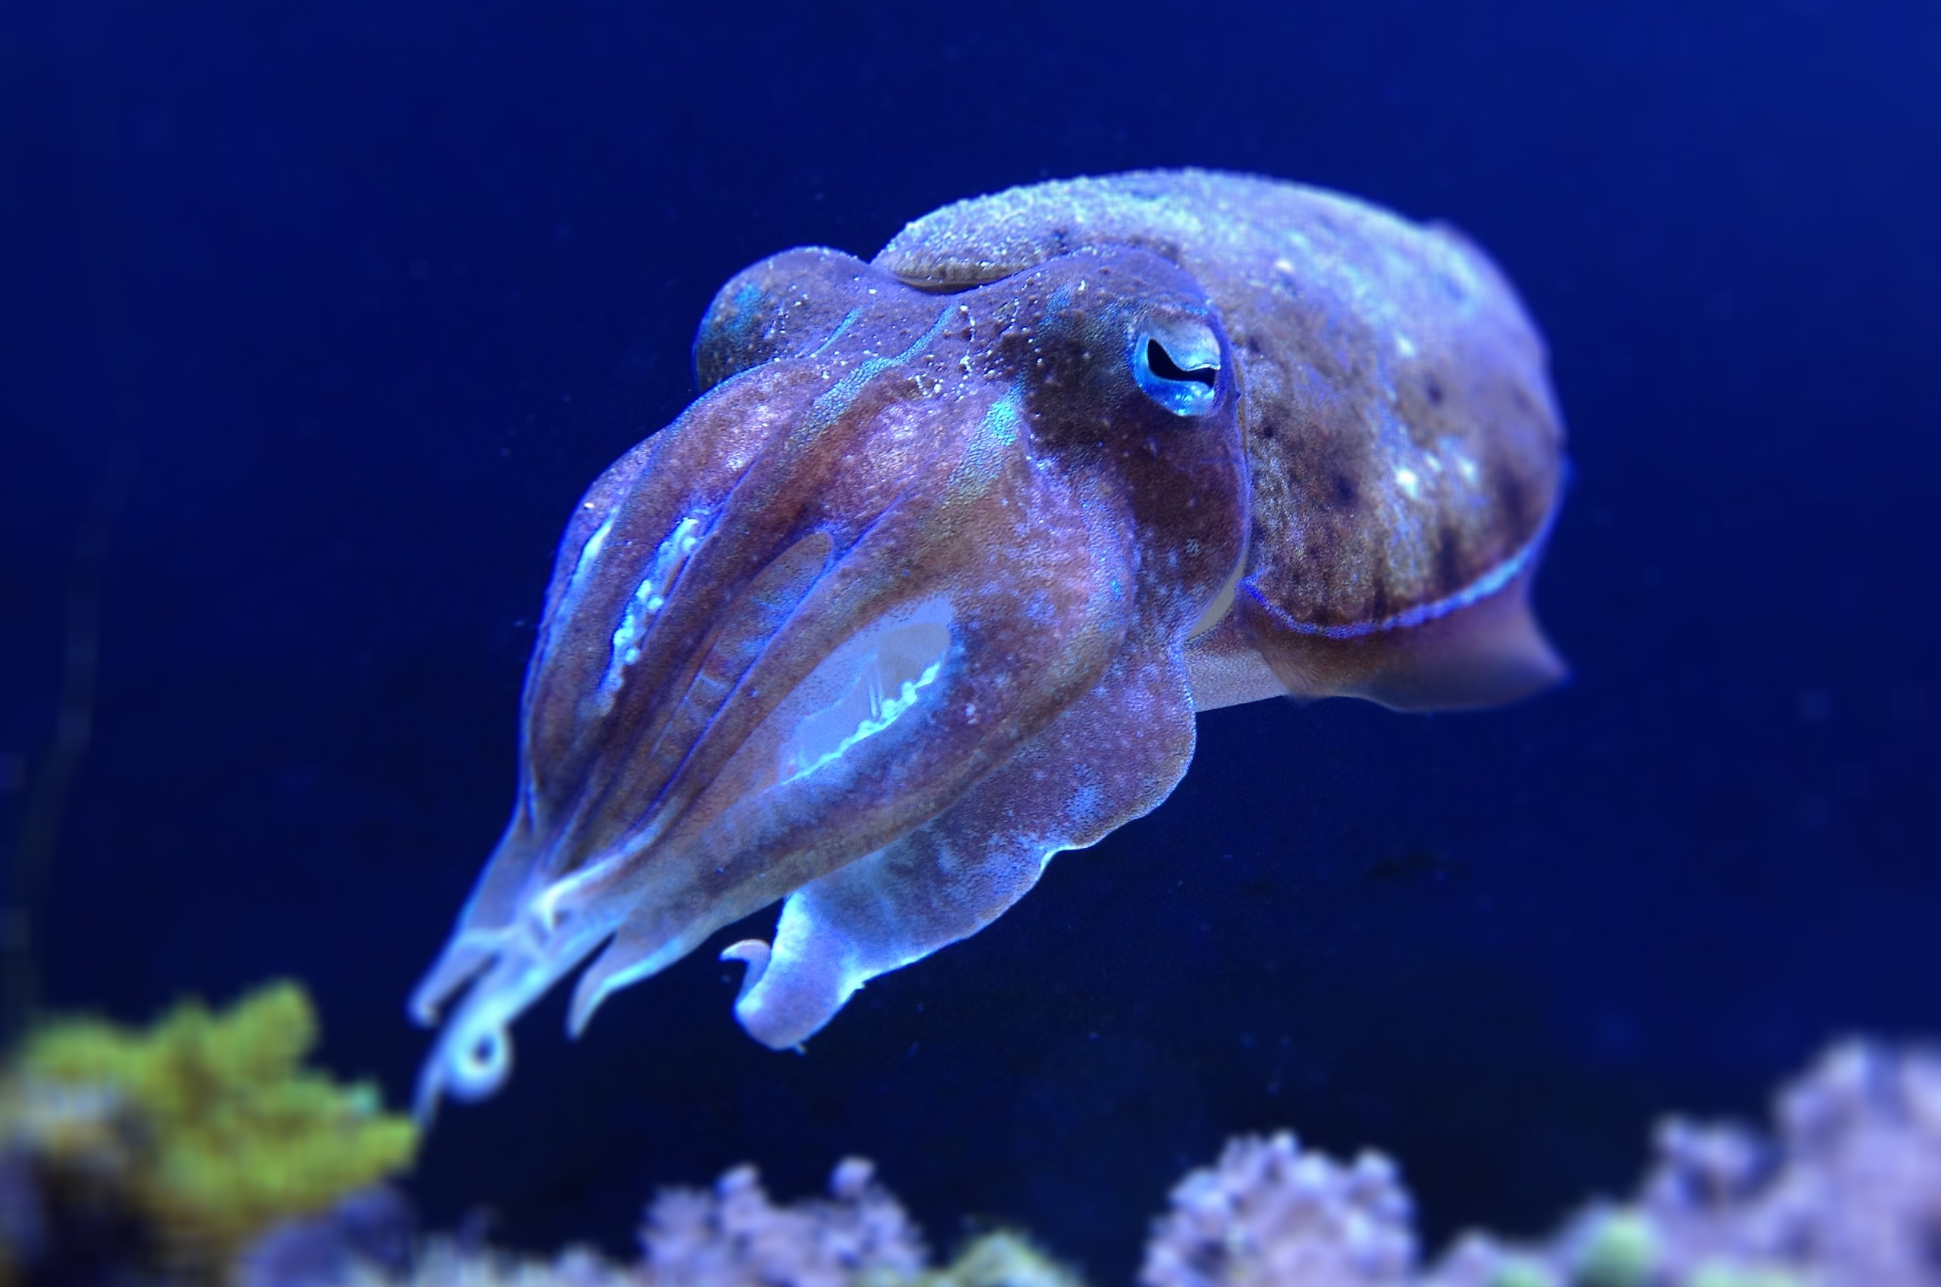
Introduction
Creatures rely on other creatures for essential resources.
Lotka found that biological relationships could be modeled similar to chemical relationships.
The predator prey relationship is the biological relationship with the most direct exchange of resources.

Slide 3
Goal/Motivation
To model predator prey relationships
Determine Limiting Cases
Determine which coefficients lead to stable data (neither population shows clear, steady oscillations)
Determine how the severity of certain circumstances affect populations.

Slide 4

Model
Lotka-Volterra Equations
Consists of a system of ODEs solvable by using numerical methods
$\frac{dx}{dt}= αx − βxy, \frac{dy}{dt}= γxy − δy$
X represents the prey population
Y represents the predator population
$α$ represents the growth rate of the prey population
$β$ and $γ$ are the coefficients that represent how often they interact
$δ$ represents the mortality rate of the predator population
Added a randomizer to $α$ for the second function:
$\frac{dx}{dt}= α∗(1+ .5∗Randomizer)x − βxy$

Slide 5
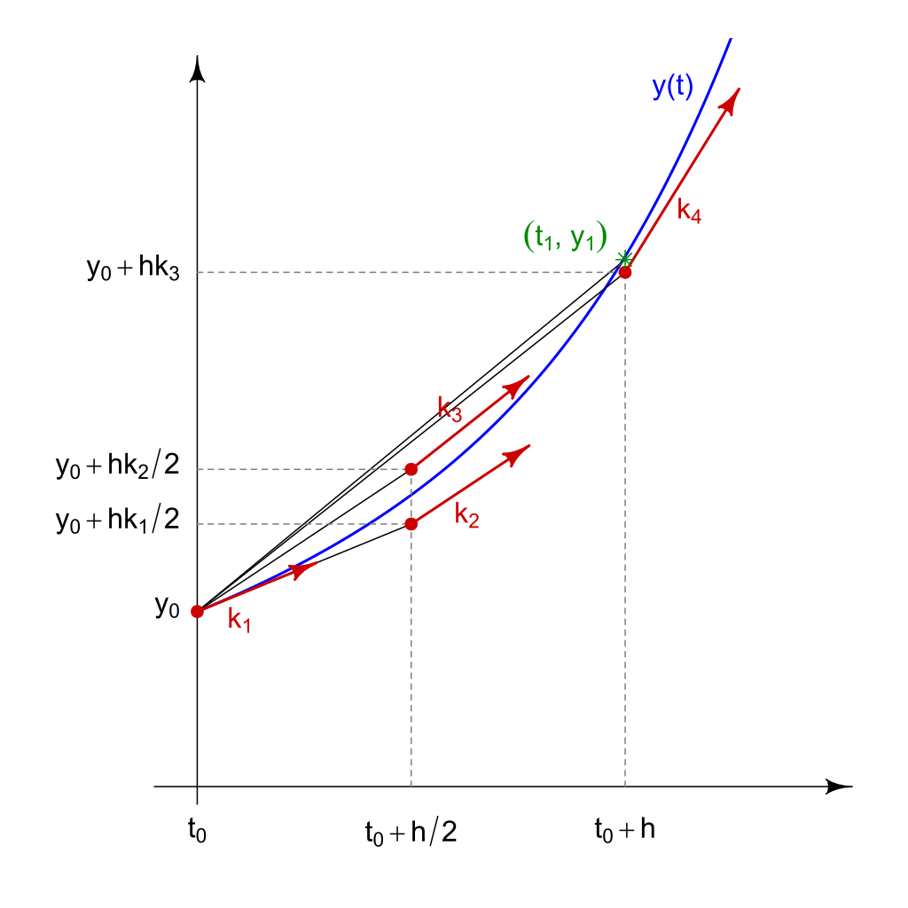
Numerical Methods
Three total functions within my code
First produces arrays of the Lotka-Volterra equations (ODEs)
Second produces the same but with a random factor
The fourth order Runge-Kutta method is used in this project as the solving method
Produced arrays of both populations and time to be plotted
Used Method because of its high accuracy

Slide 6
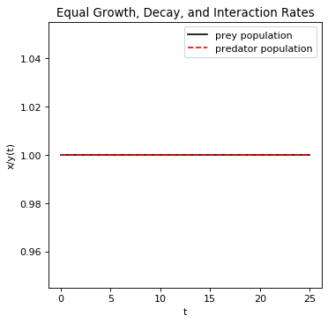
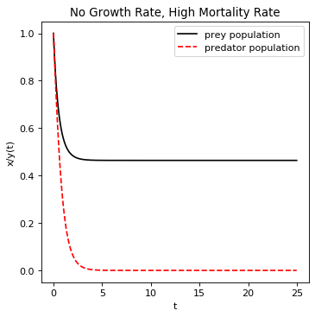
Results: Limiting Cases
All graphs show time on the x-axis and population on the y-axis

Slide 7
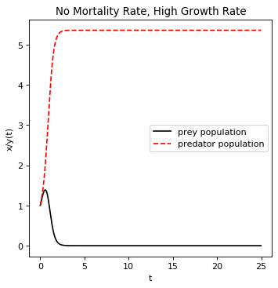
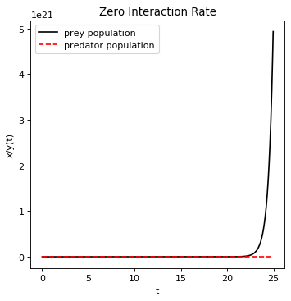
Limiting Cases Cont.
No Mortality Rate, High Growth Rate
Zero Interaction Rate

Slide 8
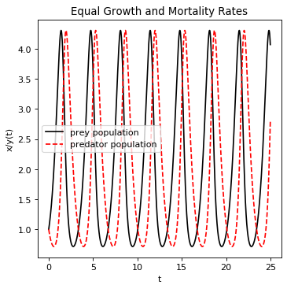
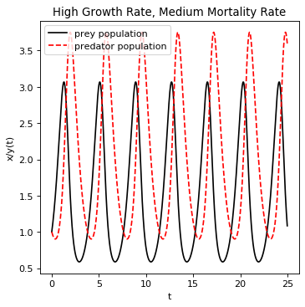
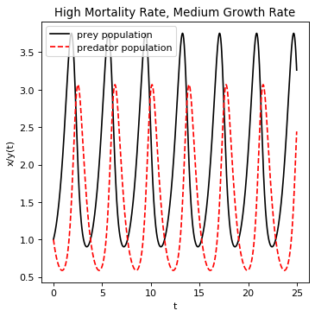
Results: Stable Cases
The following graph shows stable cases.
Equal Growth and Mortality Rates
High Growth, Medium Mortality
High Mortality, Medium Growth
There are consistent oscillations that show a steady population

Slide 9
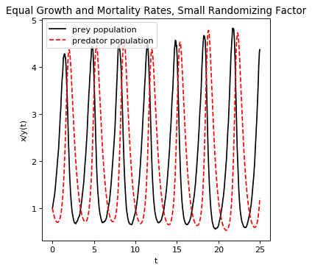
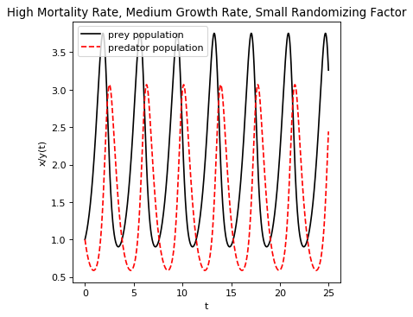
Results: Randomizing Factor Introduced
Introduced a randomizing factor to see how it would affect stable population models
Slight deviations from the graph without a randomizing factor
Further proves the predator population is heavily dependent on the prey population

Slide 10
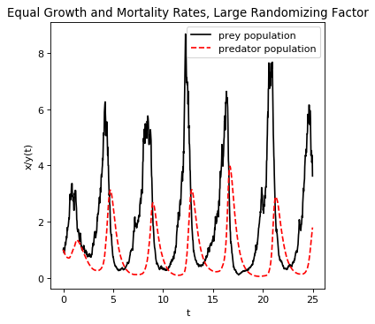
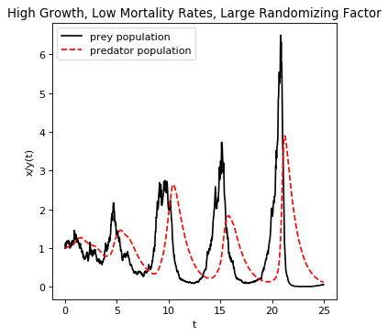
Results: Severity vs. Stability
Next step is to determine which model is most stable.
In other words, how great of a randomizer can the model withstand
Ultimately found that the equal growth and mortality rates produced the most stable graph
Equivalent randomizing factors were used, but the high growth, low mortality graph showed large deviations, and ultimately ended up extinct

Slide 11
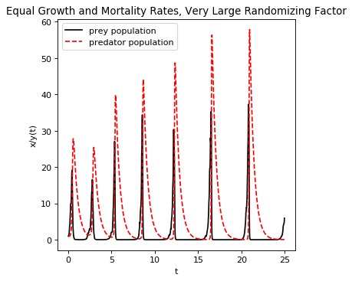
Analysis:
Very clear trend within the graphs
They oscillate and the predator population peaks “follows” the prey population
Most stable graph is the “Equal Growth, Decay, and Interaction Rates”
This is logical, but not practical

Slide 12
Analysis: Cont.
There are certain scenarios in which the code does not model a real world relationship (Limiting Cases).
This is not proof that the code does not work, but proof that the constants do not make any sense
i.e., a mortality rate/ growth rate of zero is not possible.
A zero interaction rate is no plausible

Slide 13
Analysis: Cont.
Found that the equal growth and mortality rates graph is the most stable, realistic graph and is able to withstand the harsher circumstances.
For the relationship to be stable, they must have similar growth and mortality rates.
The interaction rate does not have a great effect on the graphs. It either speeds up or slows down
It took a very large randomizer to consistently make this relationship unstable

Slide 14
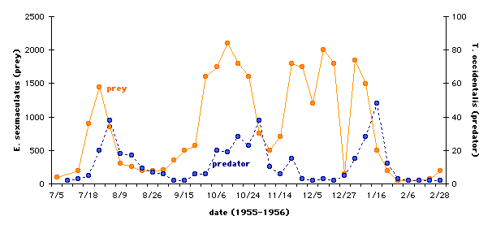
Analysis: Cont.
The most comparable data to a real world population model is with the large randomizing factor with equal growth and mortality rates.
Huffaker’s experiment with mites produced a predator prey model shows very similar features.

Slide 15
Analysis: Cont.
The small and medium randomizing rates represent very minute changes in the environment
The populations are altered slightly because of it
The large randomizing rates best represent real world data because it resembles Huffaker’s experiment
The very large randomizing rate is a major catastrophe to the environment the creatures live in.
i.e, a natural disaster, severe climate change, deforestation.

Slide 16
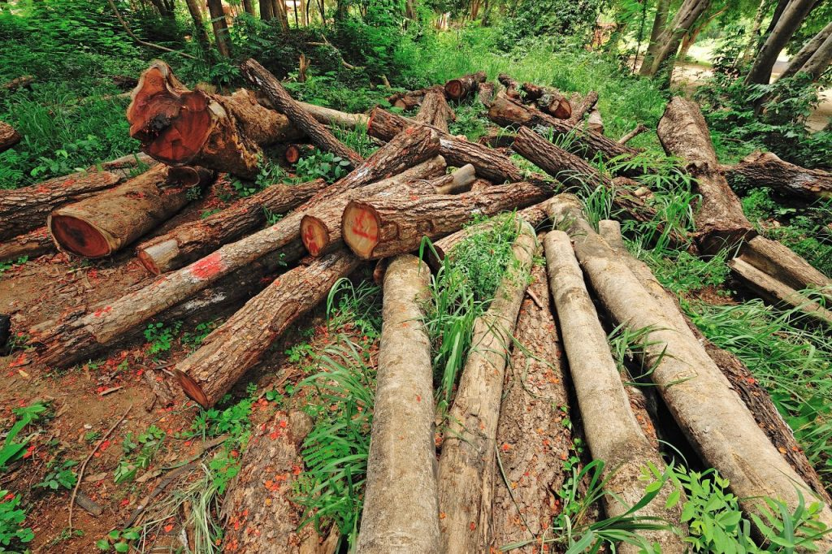
Summary
If there are no extreme events/circumstances, then relationships with similar growth and mortality rates will be stable cycles that oscillate without the worry of extinction.
In a natural environment, similar growth and mortality rates will suffice and will be less susceptible to deviations in population than environments in which the growth and mortality rates differ greatly.
The equal growth rate and mortality rate with a large randomizing factor best resembles experimental data modeling real interactions.

Slide 17
References
Newman, Mark E. J. Computational Physics. Createspace, 2013.
Kingsland, Sharon. “Alfred J. Lotka and the Origins of Theoretical Population Ecology.” PNAS, National Academy of Sciences, 4 Aug. 2015, www.pnas.org/content/112/31/9493.
“Mutualistic Relationships.” New England Complex Systems Institute,
Beals, M. “Predator-Prey Dynamics: Lotka-Volterra.” PREDATOR-PREY DYNAMICS, 1999,
Cheever, Erik, and Swarthmore College. Fourth Order Runge-Kutta,

Slide 18
Questions?

